Slide 1
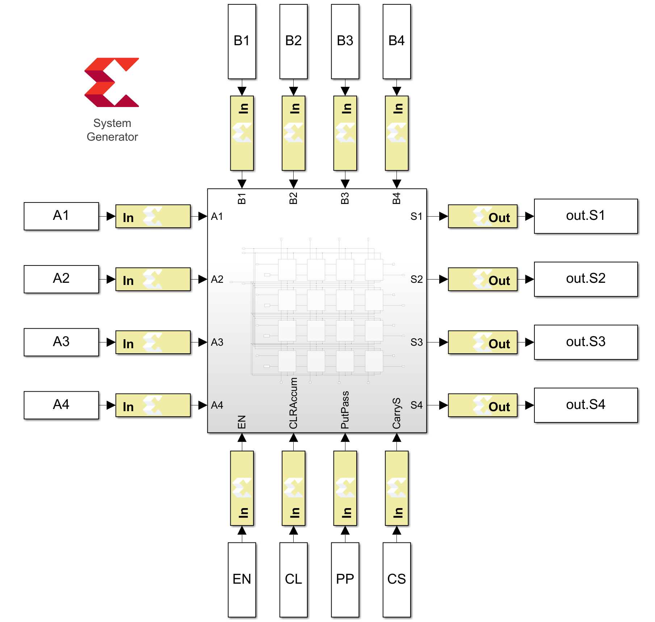
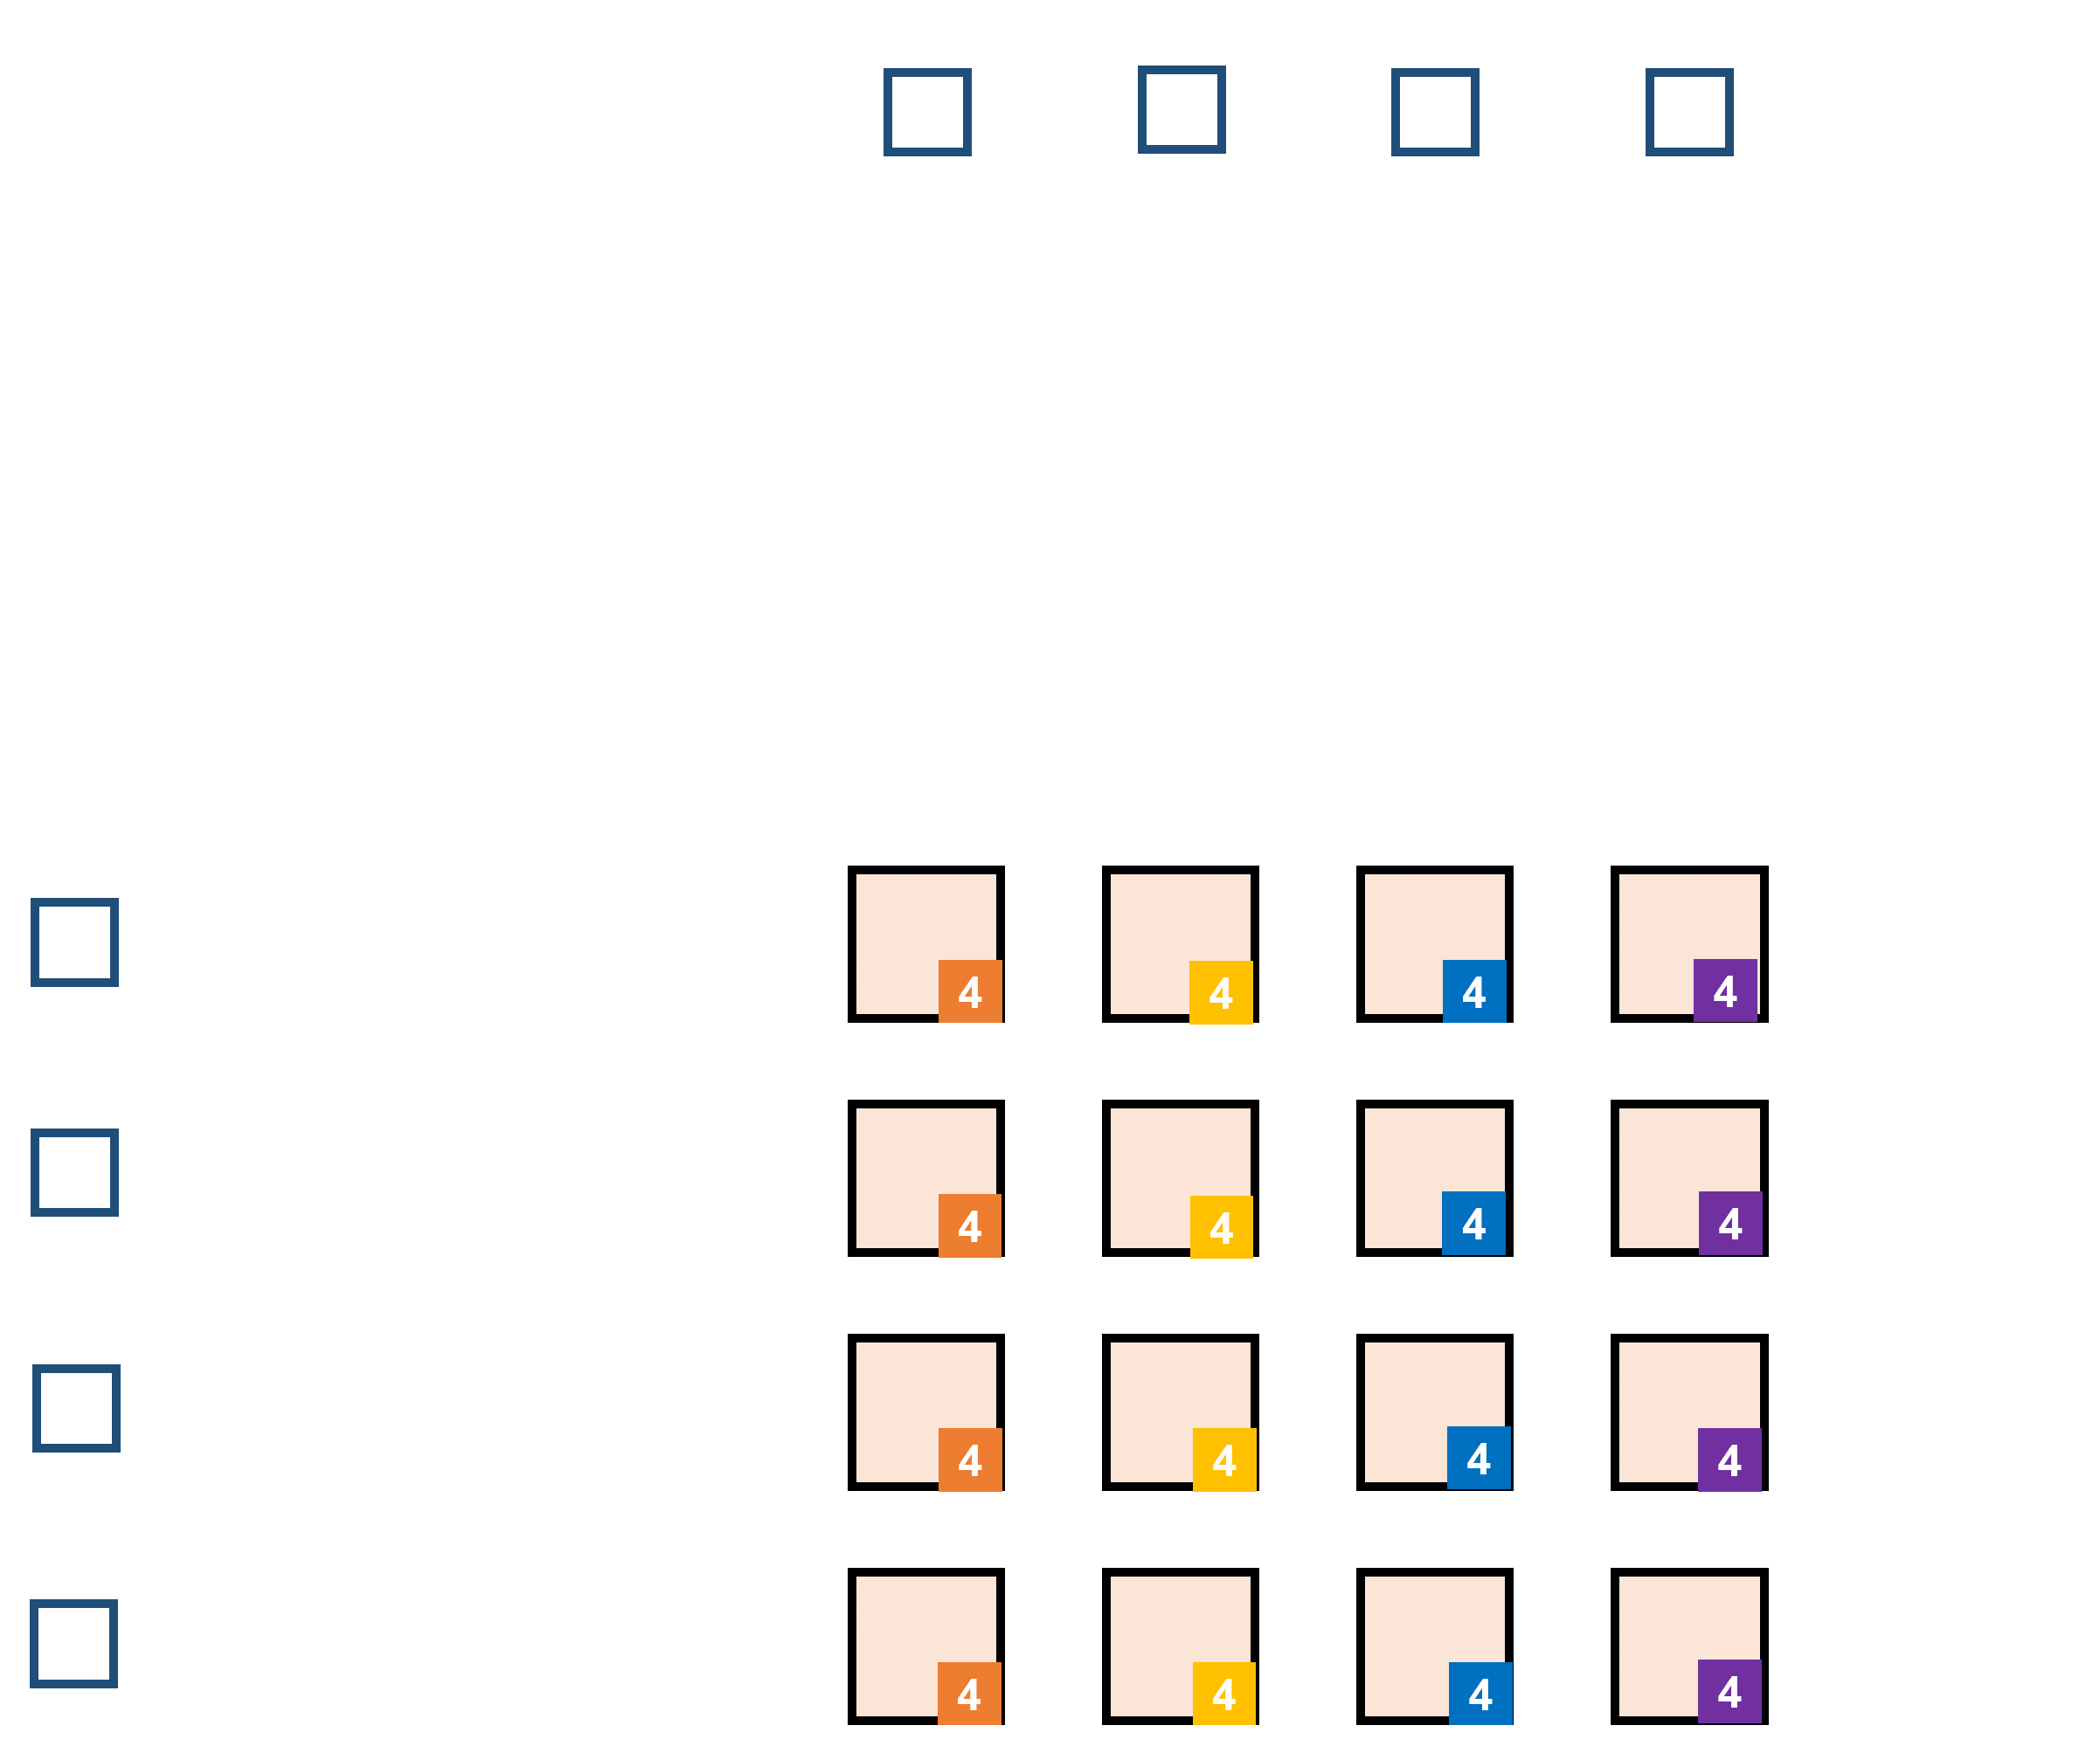
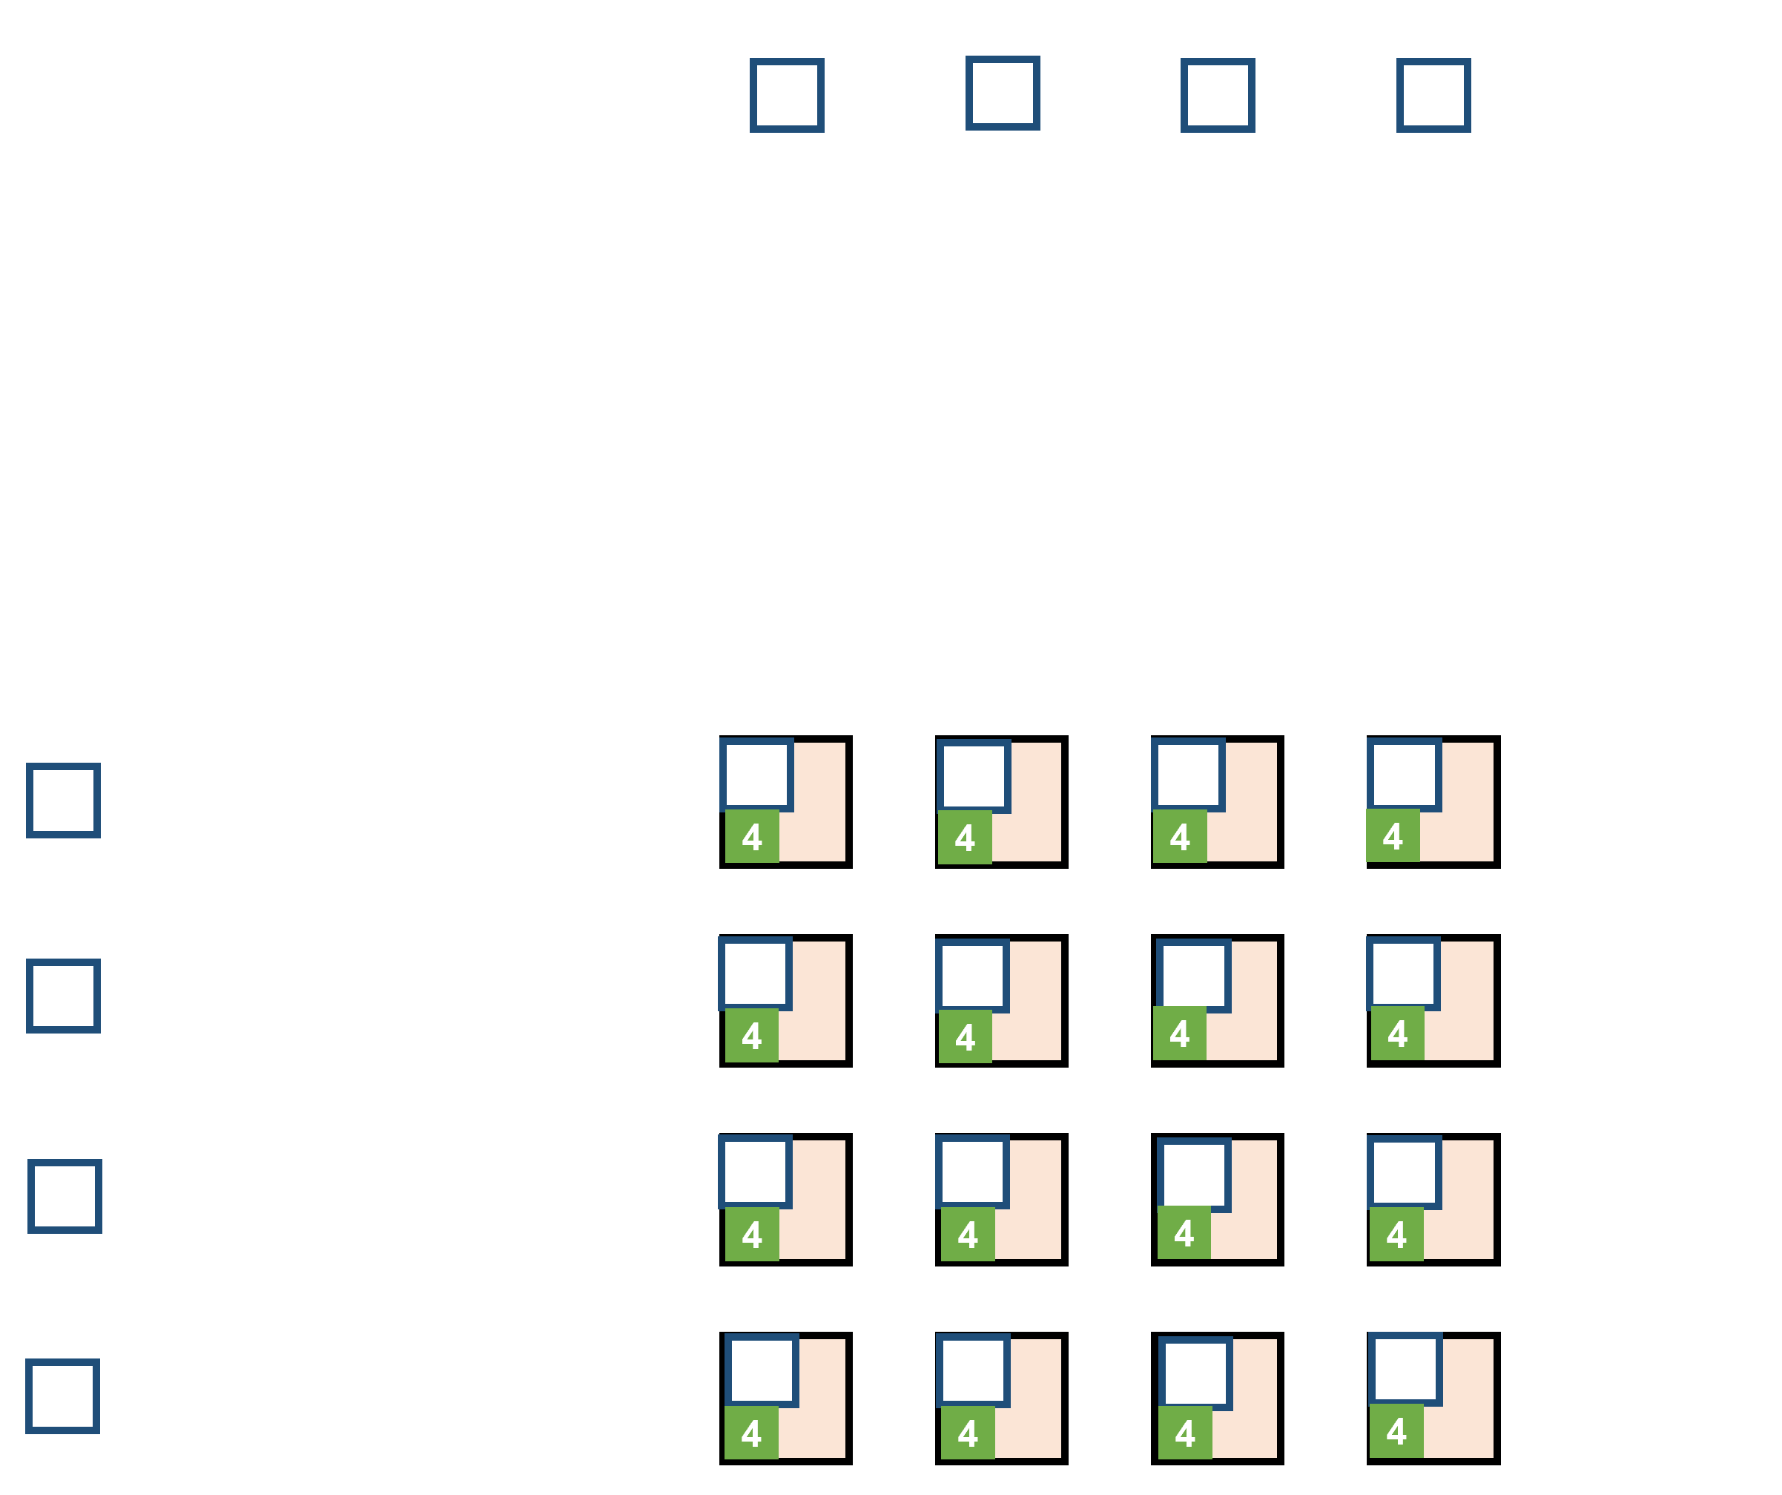
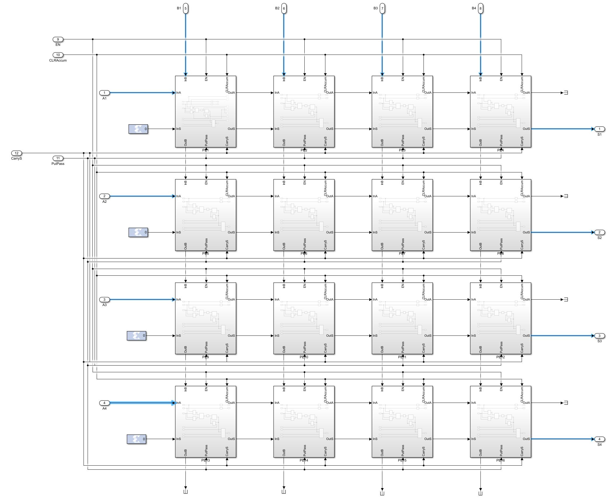
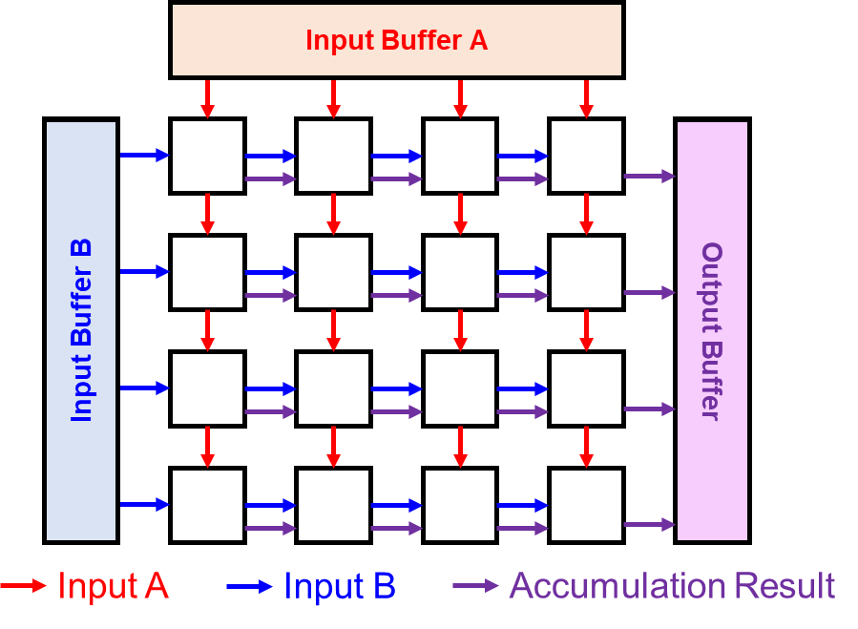
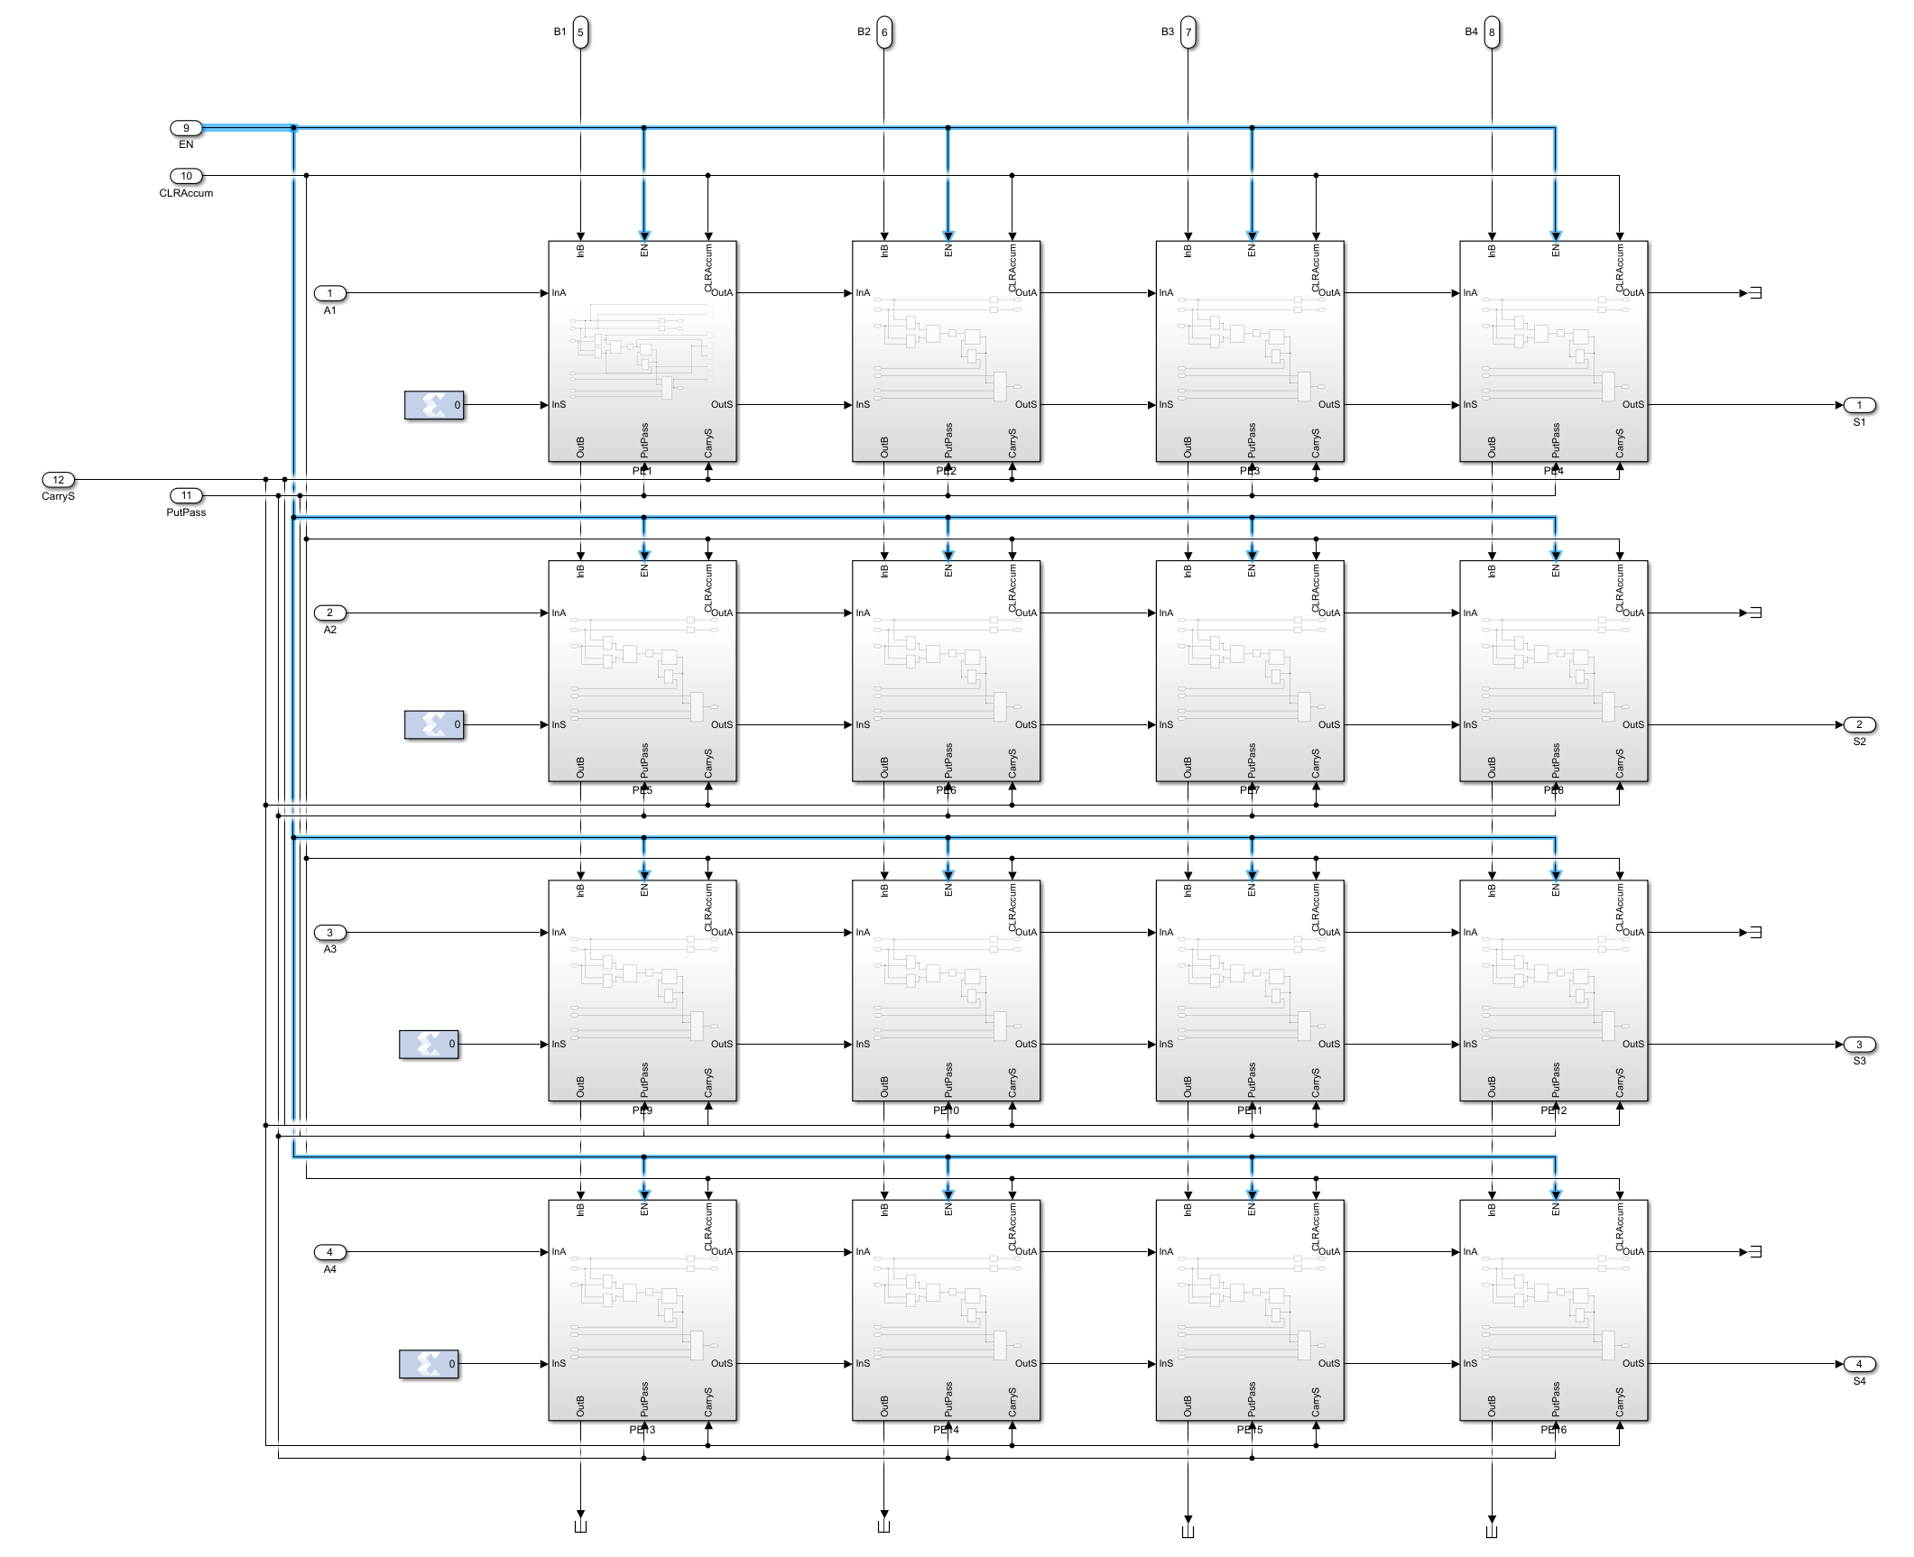
Project 2 Systolic Array for Matrix Multiplication – PE Array
Sixu Li
Stage 1
Systolic
Compute
Stage 1
Complete
Stage 2
Move
Sum
Stage 3
Pass
Sum
Constrains:
<=200 top module IO
Compute I/O:
64-bit input port A, 64-bit input port B, 64-bit output port S. All 16x4
Control I/O:
Clear Accumulation, Input Enable, Put Accum, Carry Accum
Requirement:
Matrix – Matrix Multiplication
Vanilla Systolic Array
Matrix – Vector Multiplication
Subset of MMM, waste idle components

Slide 2
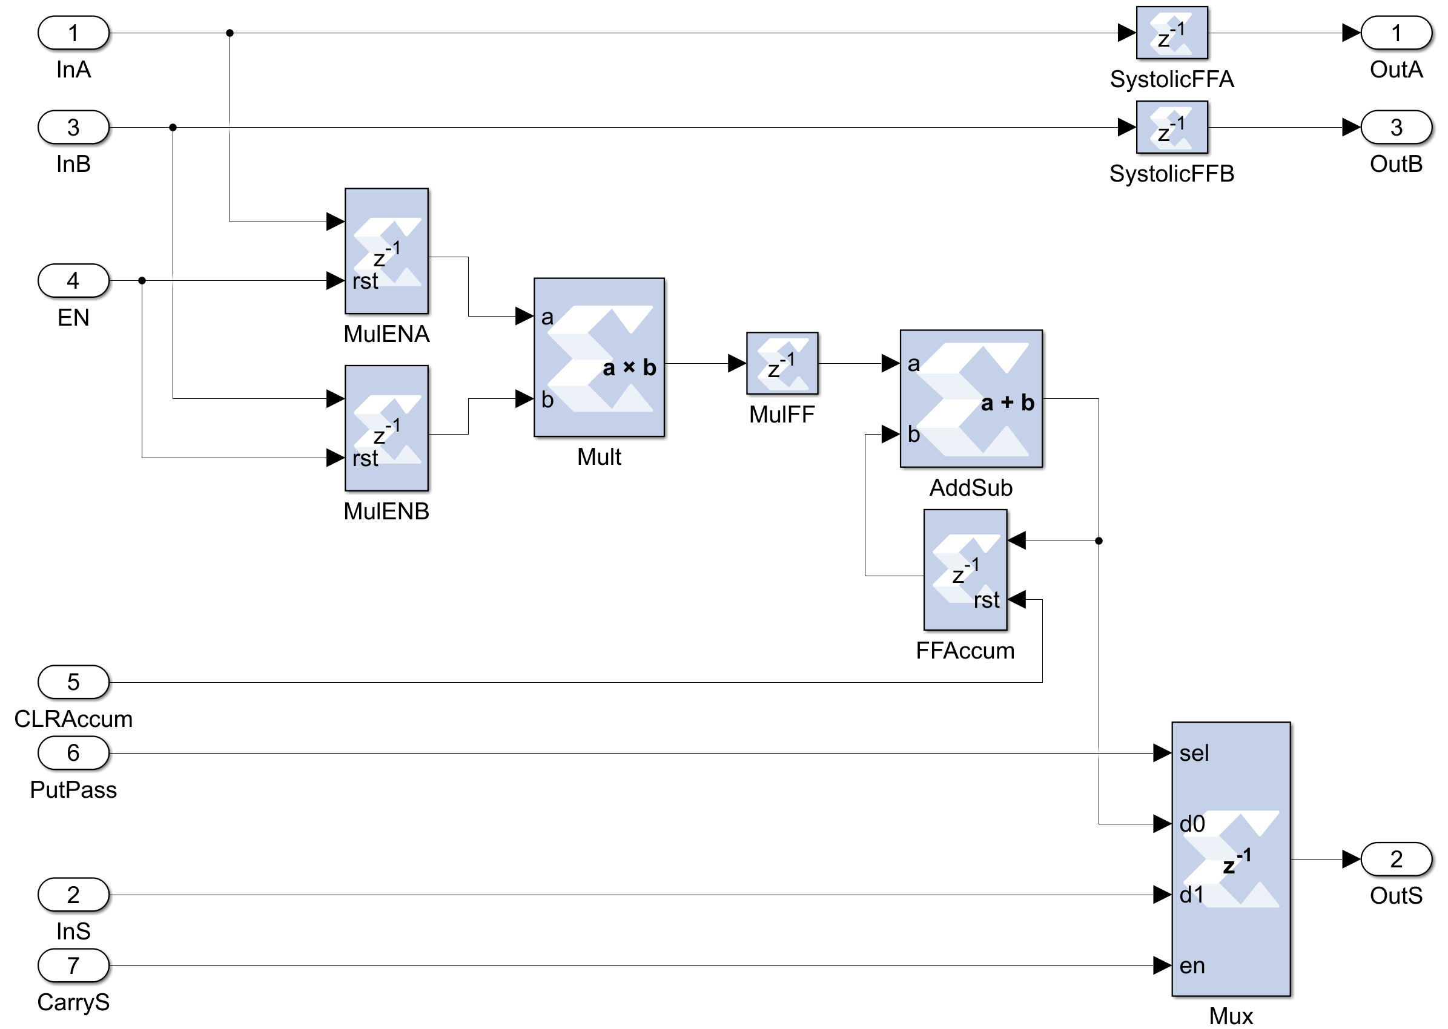
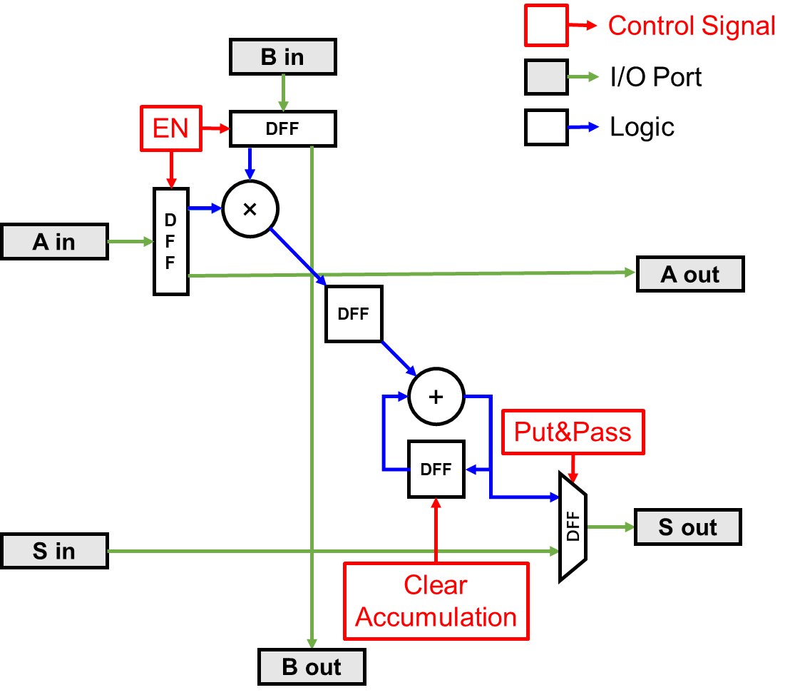
Project 2 Systolic Array for Matrix Multiplication – PE
Sixu Li
Requirement:
Multiplication
Accumulation w/ clear
Register Accumulation Result
Pass Accumulation Result
Used Building Blocks:
Multiplier
Adder
DFF with Enable / Reset
Mux

Slide 3
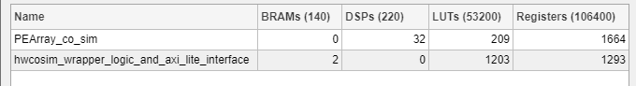
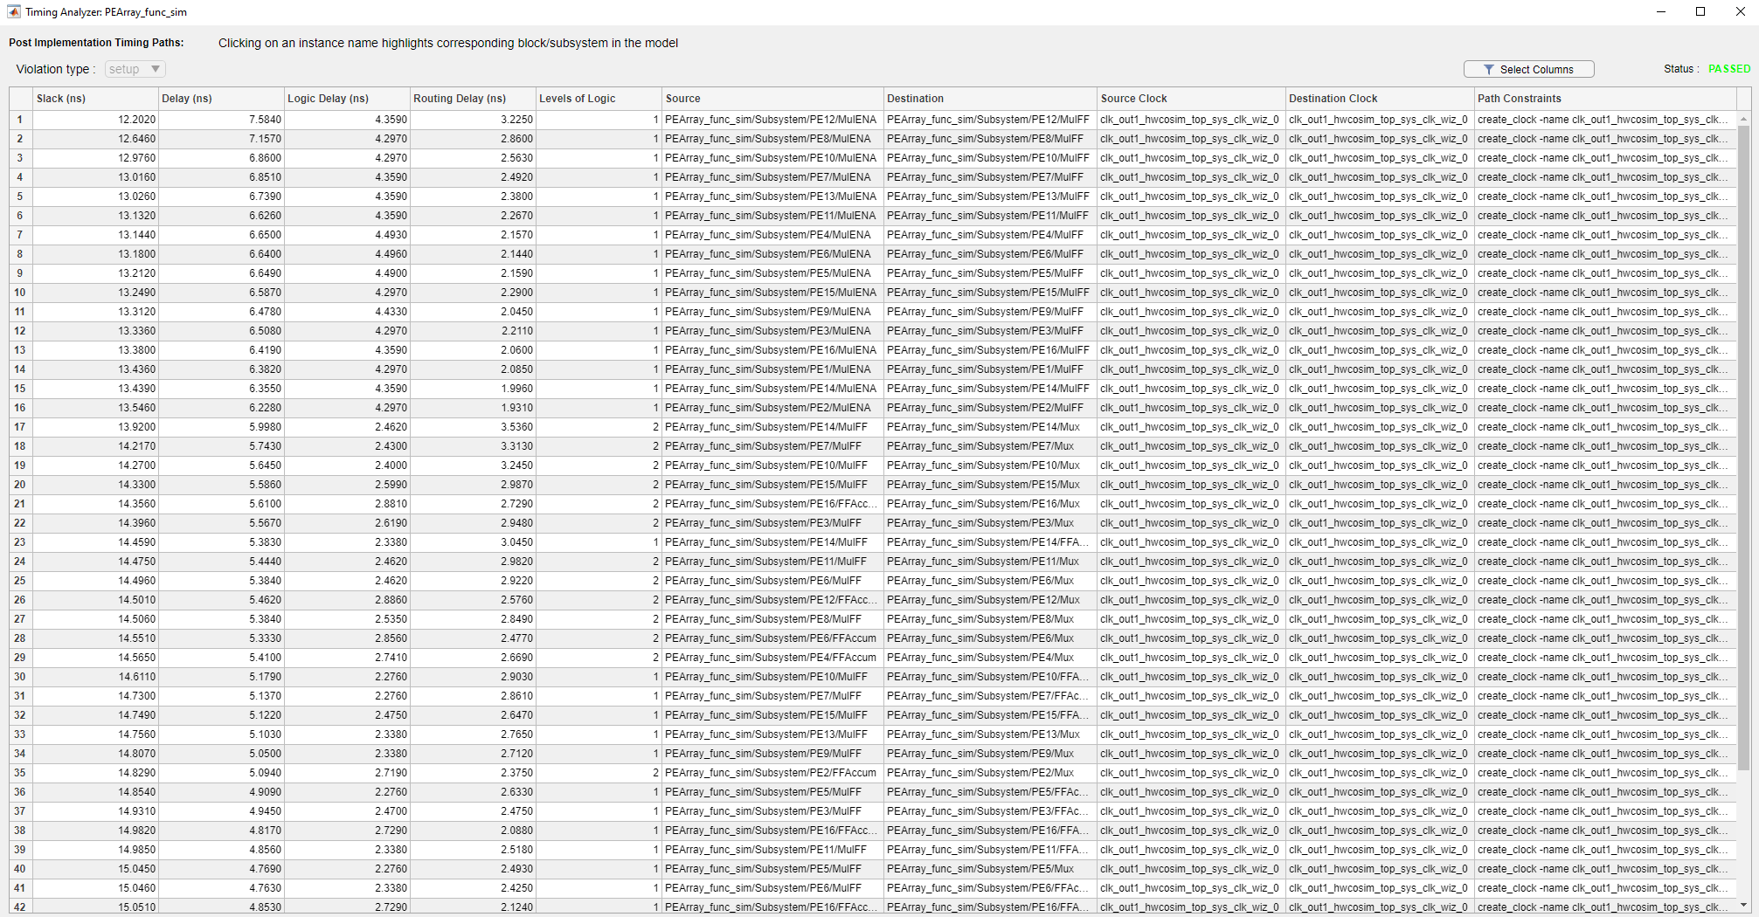

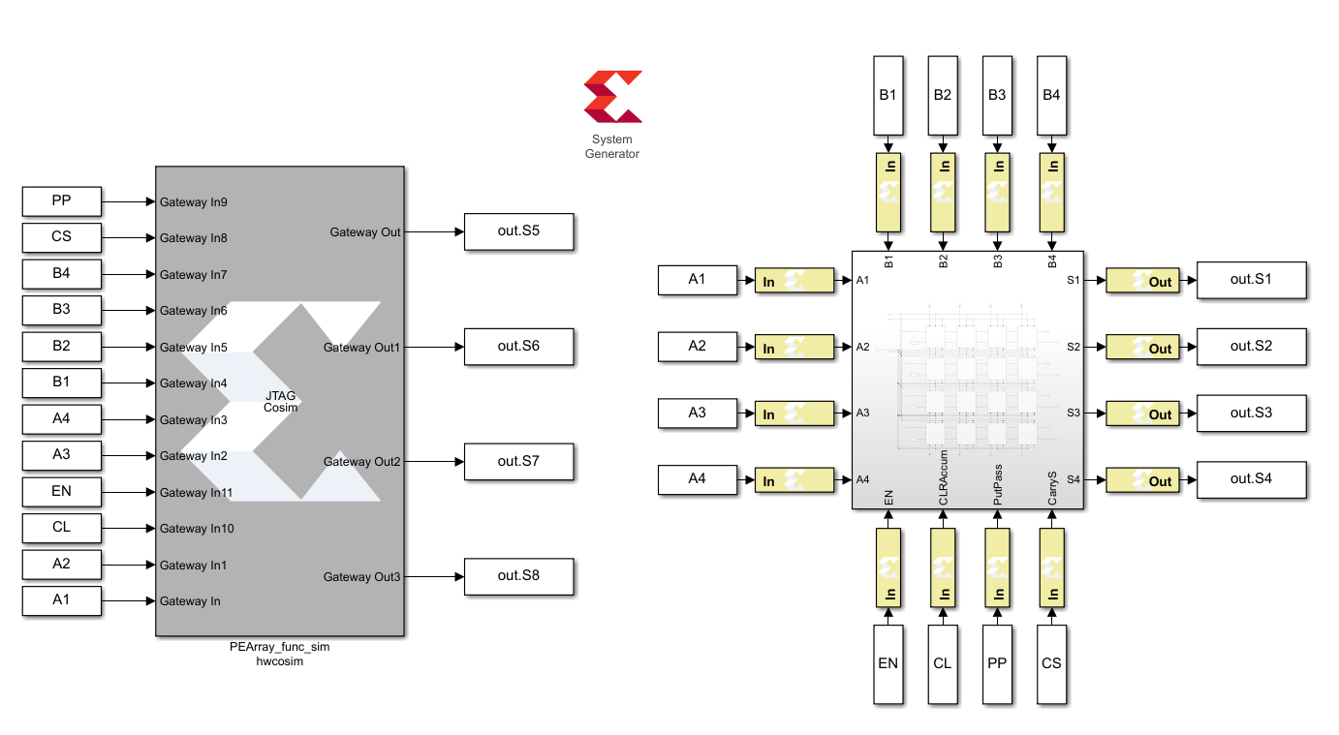
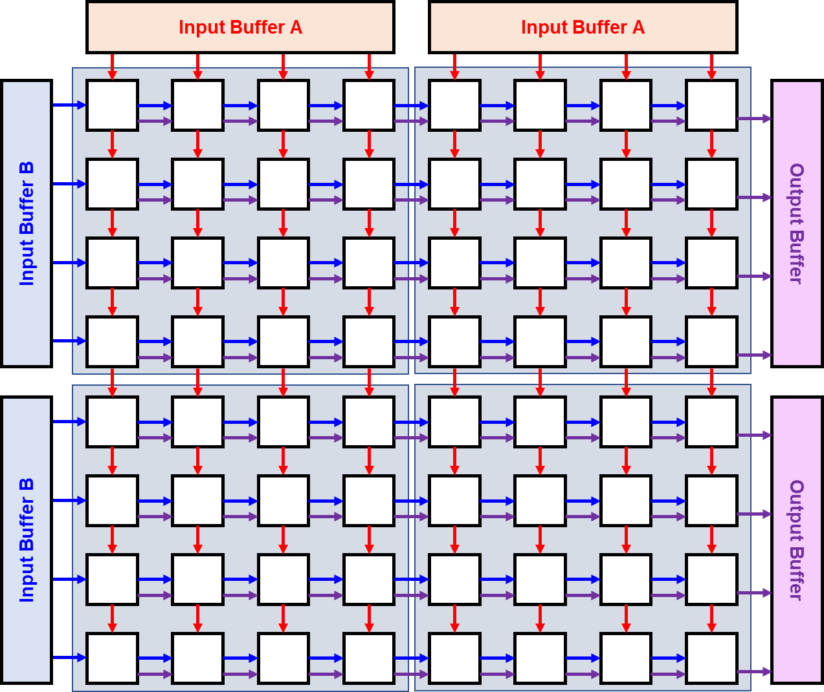
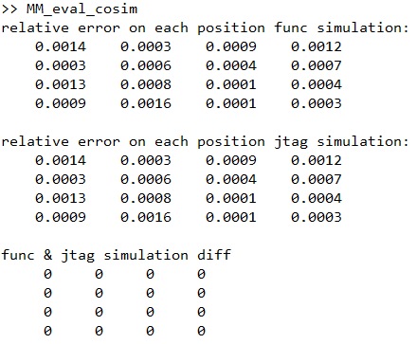
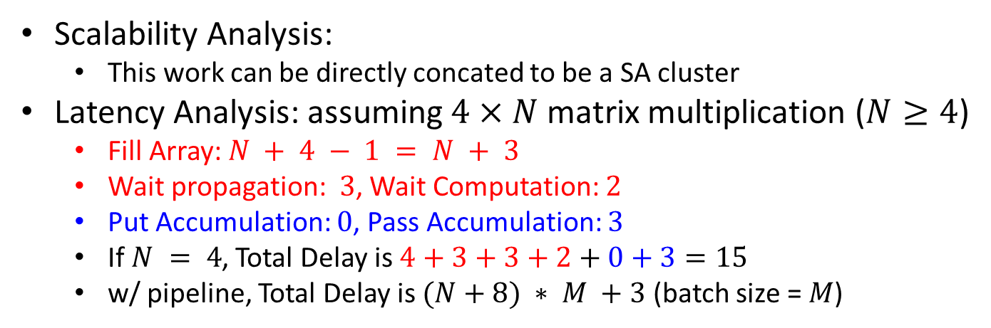
Project 2 Systolic Array for Matrix Multiplication – Evaluation
Sixu Li
Area:
LUT: 209
FF: 1664
DSP: 32
Timing:
50MHz
Worst slack 12.20ns
Test Results:
Eval Matrix: Relative Error
Scalability Analysis:
This work can be directly concated to be a SA cluster
Latency Analysis: assuming $4×N$ matrix multiplication ($N≥4$)
Fill Array: $N + 4 − 1 = N + 3$
Wait propagation: $3$, Wait Computation: $2$
Put Accumulation: $0$, Pass Accumulation: $3$
If $N = 4$, Total Delay is $4+3+3+2+0+3=15$
w/ pipeline, Total Delay is $(N+8) ∗ M +3$ (batch size = $M$)
1
2
3
1
2
3
1
2
3
1
2
3
Future Work:
Matrix – Vector Multiplication
Option 1: Subset of MMM, waste idle components (This work)
Pros: Simple; Cons: Power Waste
Option 2:Vector/Broadcast Systolic Array + Adder Tree
Pros: Best in Latency; Cons: Worse Timing, Complex
Option 3: Subset of MMM, gate idle components (Future Work)
Pros: Energy Saving; Cons: More I/O
Built in FSM control based on instruction instead of direct control
More I/O, Timing
1
2
3

